Slide 1



DO NOT CONTINUE IF YOU ARE UNSURE ABOUT REQUIREMENTS
WE ONLY WANT PROFFESIONALS!
Do you have the skills to calculate very complex mathematical equations regarding statistics and historical data?
Have you worked with Python before and know how to build effective UX applications?
Do you have good knowledge of Machine Learning/AI/Neural Networks/LSTM/GRU and much more?
Do you have good knowledge about trading and trading strategies, markets, pricebars, patterns and indicators?
Do you have references of web applications you have produced before?
If NO or unsure on any question 1-5: Thank you for your time and interest but this is not the project for you.
If YES then you are the one we are looking for – Welcome to this project presentation and please continue!
EPISEC.se
/Johan Graf CEO

Slide 2
Index
Purpose of application and about us Page 3
Risk to reward & time frame Page 4
Technical indicator Page 5-7
Candlestick patterns Page 8
Chart patterns and Machine learning Page 9-10
Trading Laboratory Page 11-18
Trading Dashboard Page 19-22
Summary Page 23

Slide 3

Purpose and project vision:
Trading Odds Manager is a online trading tool and website that calculates the odds to win a financial trade in real time. This is done by predictions using the different trading dimensions. This application is only one of many applications/tools a trader uses before making a decision. Nothing is by any means new in this application and vision except it illustrates the market from different dimensions and predicts the outcome of the trade. All done super easy, fast and user friendly!
1.
RISK TO REWARD RATIO
2.
TIME FRAMES
3.
TECHNICAL INDICATORS
4.
CANDLESTICK PATTERNS
5.
CHART PATTERNS/AI
About us:
EPISEC.se is a Swedish Company that works with Risk & Security applications for end users and organizations.
Trading dimensions

Slide 4
Web application – Trading odds manager
1. RISK TO REWARD DIMENSION / 2. TIME FRAMES – BASED ON BROAD HISTORICAL DATA:
For any given asset there is an optimal risk to reward setting for each time frame (1 or 5 min etc). But what is it?
Video on this topic: https://www.youtube.com/watch?v=lHhtVfeoCdQ & https://www.youtube.com/watch?v=b41bnRnSLgs
Basics:
Trading Gold for instance on a 15 min chart. If you place a random trade what would the historical optimal target and stopp loss ratio be for a sell or buy order? The historical data will tell us what would be the best bet considering risk to reward ratio!
Example:
If we would bet that Gold index will go up in price we place a buy/long order.
The rule would be to close the trade when either your target is hit at lets say +250 USD or +2.21% (example only)
Or the trade goes against you and your stopp loss is hit at lets say -125 USD or -1.11% (example only)
Your assignment:
Create a calculation application that will answer the following question:
What is the best risk to reward ratio for the asset and time frame you are about to trade - based on historical data?
The app will calculate in real time best buy and sell risk to reward strategy and win ratio for the asset and time frame.

Slide 5
Web application – Trading odds manager
3. TECHNICAL INDICATORS DIMENSION – BASED ON BROAD HISTORICAL DATA:
For any given asset there is an optimal settings for a technical indicator for each time frame. But what is it?
See this report to get an idéa of what type of technical indicator optimazation we are looking for:
http://etfhq.com/blog/2013/01/15/golden-cross-which-is-the-best/
Basics:
Most of the trading technical indicator has settings to customize the indicator. That is because you can optimize it for the asset volatility and time frame you wish to use.
See this general technical analysis overview: http://www.mrao.cam.ac.uk/~mph/Technical_Analysis.pdf
Example:
Moving Average - MA or versions of it like Exponential Moving Average use past data to plot a line on the chart.
You can get trading signals from many techniques using MA. One common practice it to use two different MA-pair to get buy or sell signals crosses. But which setting is the most profitable?
Your assignment:
Create a calculation application for indicators (in this assignment up to 66 different indicators) that will answer the following question: When trading an asset what is the most profitable setting for this technical indicator and time frame - based on historical data?
Important Note: Some indicators have more then one way to trigger a signal for buy/sell! (all must be considered/tested)
Continue next page:

Slide 6
Web application – Trading odds manager
3. TECHNICAL INDICATORS DIMENSION – 66 TYPES:
Continue next page:

Slide 7
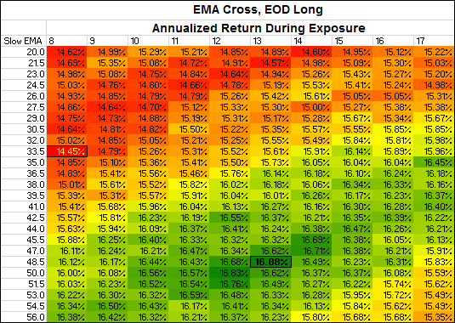
Web application – Trading odds manager
3. TECHNICAL INDICATORS DIMENSION – BASED ON BROAD HISTORICAL DATA:
The app will calculate best profitable setting for buy and sell for the asset and time frame you backtest.
The result could be presented to look something like this for Daily time frame:

Slide 8
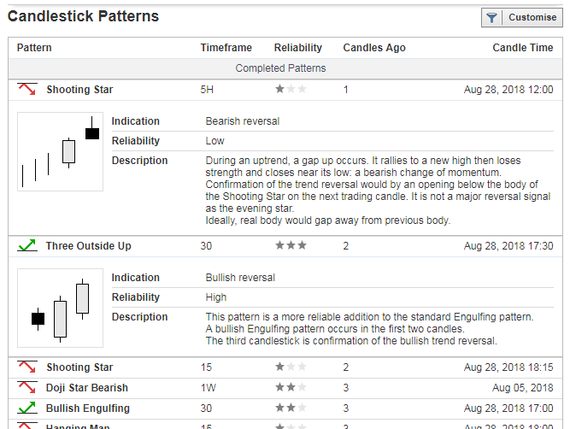
Web application – Trading odds manager
4. CANDLESTICK/PRICE BAR PATTERNS INDICATORS DIMENSION – BASED ON BROAD HISTORICAL DATA:
We know price action tends to follow specific patterns. There are about 65 main candlestick patterns we must backtest.
What candlestick pattern is the most effective, can we rank them?
See this page for more info on types of candlestick patterns:
https://www.candlesticker.com/BullishPatterns.aspx?lang=en
https://www.candlesticker.com/BearishPatterns.aspx?lang=en
Investing.com has a very nice presentation!
Your assignment:
Create a calculation application that calculate the win ratio and optimal risk to reward setting for that candlestick pattern and time frame and asset - based on historical data.

Slide 9
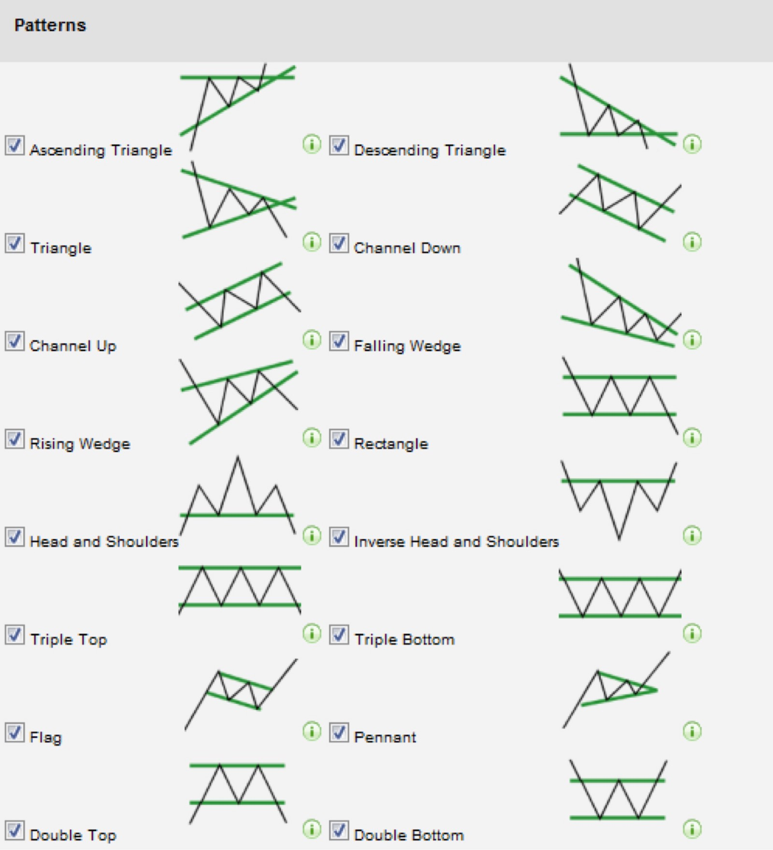
Web application – Trading odds manager
5. PART 1: CHART PATTERNS DIMENSION – BASED ON BROAD HISTORICAL DATA:
We know price action tends to follow specific chart patterns. There are about 10 patterns or 20 if inversed we must backtest.
What chart patterns is the most effective, can we rank them?
See link for more info:
https://optionalpha.com/13-stock-chart-patterns-that-you-cant-afford-to-forget-10585.html
Your assignment:
Create a calculation application that calculate the win ratio and optimal risk to reward setting for that chart pattern and time frame and asset.
Based on historical data.

Slide 10
Web application – Trading odds manager
5. PART 2: CHART PATTERNS DIMENSION MACHINE LEARNING – BASED ON BROAD HISTORICAL DATA:
Does price action/charts have memories, can we predict the market better then 65% into the future based on historical data?
Your assignment:
Create an AI/LSTM/Machine learning or other prediction model using as many inputs as necessary to predict future of chart with an accuracy of 65% or more. This is a trial and error assignment and will require deep knowledge in trading and machine learning. This is not a task for an “average programmer”!
See video and pdf for inspiration
https://www.youtube.com/watch?v=ftMq5ps503w
https://arxiv.org/pdf/1808.03867.pdf
https://www.kaggle.com/raoulma/ny-stock-price-prediction-rnn-lstm-gru
Your assignment:
Create prediction models that in realtime predicts future movements with atleast 65% accuaracy/win rate!
Store them in our AI-library
The steps to AI models could be something like:
numpy — used to easily make matrix calculations and mathematic manipulations which are essential for any ML model
pandas — used to define a nice data structure for your training data
sklearn — a tool used for data analysis (for example normalizing or clustering data)
matplotlib — used to display our data
tensorflow — Google’s open source library used for building ML graphs in an easy and elegant way

Slide 11

TRADING LABORATORY

Slide 12
CORE VALUE OF THIS SERVICE IS THIS FEATURE : TRADING LABORATORY!
BASIC LAYOUT REQUIREMENTS
NEEDS HISTORICAL AND LIVE DATA FROM SUPPLIERS LIKE YAHOO FINANCE ETC (PLEASE SUGGEST AND ADD MORE)
PLOT GRAPH LIKE TRADEVIEW.COM OR SIMULAR WITH: CANDLES, LINE, BARS, RENKO OR HEIKIN ASHI -STYLE GRAPH
LIBRARY FOR: 66 TECHNICAL INDICATORS/ 65 CANDLESTICK PATTERNS/ 20 CHART PATTERNS
LIBRARY WILL ALSO CONSIST OF MACHINE LEARNING MODELS AND OTHER CUSTOM TRADING MODELS/IDEAS

Slide 13
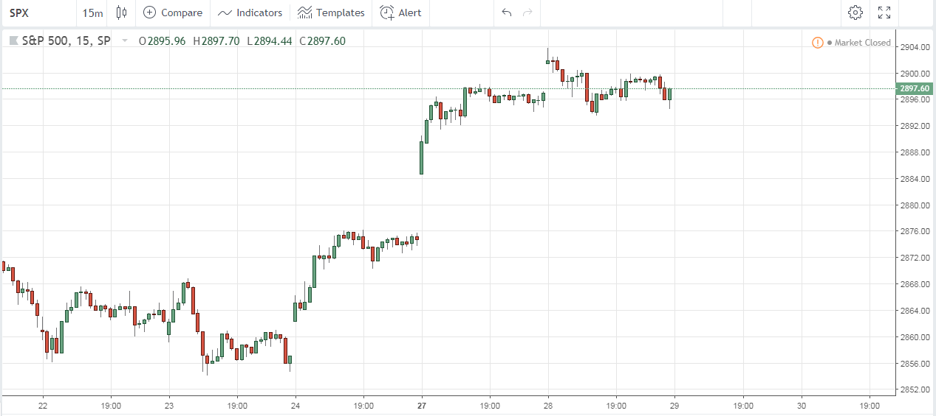
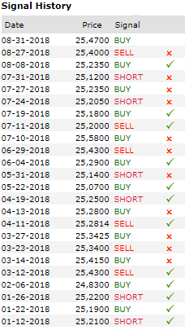
PERFORMANCE DATA
BASED ON HISTORICAL DATA
Specify date from: Year-month-day
(If not chosen max data is applied)
Best risk to reward setting for:
Buy__1:121______/ Win Ratio__51_%
Sell__1.131______/ Win Ratio__49_%
Max consecutive win streak: 12 times
Max consecutive loss streak: 11 times
Save your template
Alert when signal is generated
Categories:
Technical Indicators (66)
Candlestick Patterns (65)
Chart Patterns (20)
AI Predictions
Custom Indicators
”SUGGESTED BASIC LAYOUT OF TRADING LABORATORY”
similar to
Tradeview.com and real time data inputs

Slide 14
Step 1: Pick asset
(this example S&P500 Index)
Step 2: Pick time frame
(this example 15 min)

Slide 15
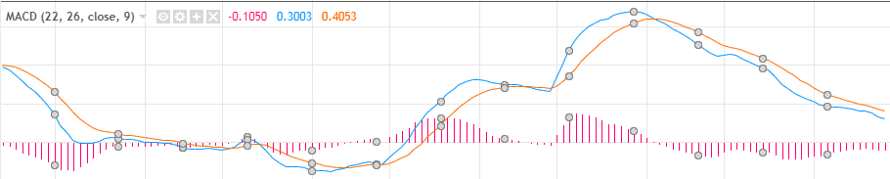
Step 1: Pick asset
(this example S&P500 Index)
Step 2: Pick time frame
(this example 15 min)
Step 3: Add filter from Indicators
Lets add a technical indicator to filter the trades. Lets say we add MACD.
(Example not fact) - We have defined that there are 3 ways this indicator can generate buy/sell signals. (Example not fact)
We pick one and add as filter. The application now runs back tests to define the optimal settings for this indicator and strategy.
Lets say it is: 22,26 and 9
To achieve best performance
Will this filter improve our
*Performance data? Yes or no?
BUY
Sell

Slide 16
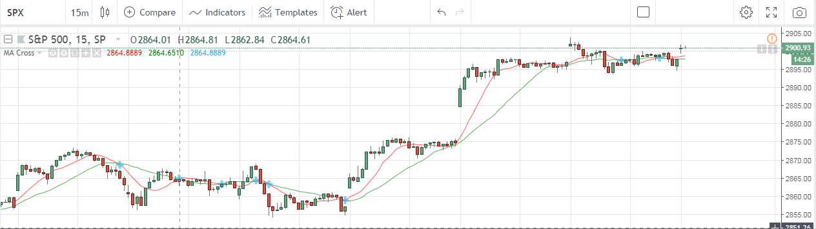

Step 1: Pick asset
(this example S&P500 Index)
Step 2: Pick time frame
(this example 15 min)
Sell
Buy
Step 4: Add another filter.
Lets add another technical indicator to filter the trades even further. Lets say we add MA Cross.
(Example not fact) - We have defined that there are 2 ways this MA Cross indicator can generate buy/sell signals. (Example not fact)
We pick one and add as filter. The application now runs back tests to define the optimal settings for this indicator and strategy.
Lets say it is MA Pair 13 and 48 to achieve best performance
Will this filter and the previous filter MACD improve our *Performance data? Yes or no?

Slide 17
Step 1: Pick asset
(this example S&P500 Index)
Step 2: Pick time frame
(this example 15 min)
Sell
Buy
Step 5: Add another filter based on Price Bar Pattern and/or Chart pattern
Lets add 4 more filters, Lets say we add Candlestick pattern: Three outside up & Three outside down
And Chart pattern: Head and shoulders & Inverse Head and shoulders
The application now runs back tests to define the optimal settings for this strategy.
Will these 4 new filter and the previous MACD and MA Cross improve our *Performance data? Yes or no?

Slide 18
Important:
The app should be able to handle up to 10 filters to give the user lots of room for exploration! (*We have a raw frame work for this, see
attachment for this project.)
We need you to help us to define and cross reference the filters. Meaning: What are the rules for filtrering and what is possible when combining the different filters? The more choices for user, the better of course!
This part need a lot of work since we want the user to feel he has many option when backtesting his strategies and filters.
*Very basic filter rule example:
What can we use as simple rules that is easy to implement?
And
Or
And/Or
Length within X pricebars of signal or time lets say X min
…..And more
Example:
Signal when indicator (1 and/or 2) is generated and (3 Or 4) within 10 pricebars
Indicator 1 Technical indicator MACD
Indicator 2 Technical indicator MA Cross
Indicator 3 Candlestick pattern: Three outside up
Indicator 4 Candlestick pattern: Three outside down
Another option is for the user to click and add AI prediction to his strategies. Here we can add different prediction models from our ”Library” for the user to add to his chart that will predict the next lets say 10-60 bars!

Slide 19
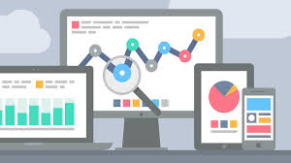
DASHBOARD LAYOUT
Framework done but need lots of improvments!

Slide 20
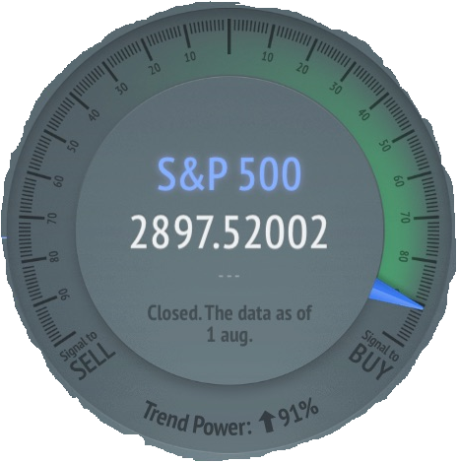
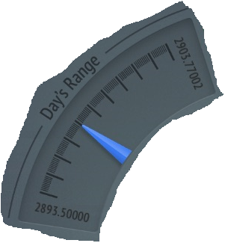
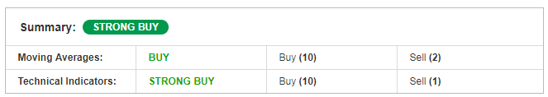
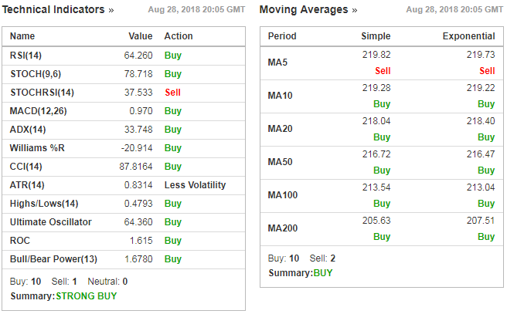
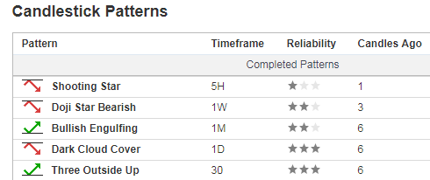
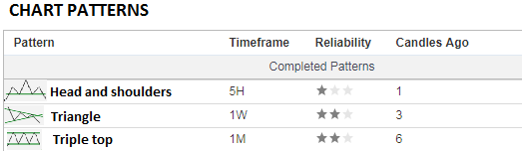
Signal
100%
TARGET
63%
Range
Select:
Daily
Weekly
Monthly
Yearly
STOPP LOSS
RISK/REWARD 1:22
37%
”Live – real time data”
0%
Past performance
Win/Loss ratio 7/10
Trade 1 - Win
Trade 2 - Win
Trade 3 - Loss
Trade 4 - Loss
Trade 5 - Loss
Trade 6 - Win
Trade 7 - Loss
Trade 8 - Win
Trade 9 - Win
Trade 10 - Win
Time Frame trend power
1 min +51%
5 min +76%
15 min +91%
30 min +67%
60 min +61%
4h +33%
Daily +67%
Weekly +55%

Slide 21
Signal
100%
TARGET
63%
Range
Select:
Daily
Weekly
Monthly
Yearly
STOPP LOSS
RISK/REWARD 1:22
37%
0%
For that Time frame (15min)
AI-Prediction plots 10-60 bars in future
How far are we from a trading signal based on our settings in Laboratory?
Main gauge that gives us the odds/risk to reward ratio and *plots it on chart. Odds for going up or down in a trade i real time in % (63% up and 37% down).
Signal strength to buy/sell
Based on user selection of:
Technical indicators and/or
Bar patterns and/or
Chart patterns

Slide 22
The 12 best performing
indicators
Moving Averages
Simple & Exponential
Last 5 Candlestick Patterns
Past performance of strategy chosen in Trading Laboratory
Quick strength overview of the other time frames
Summary of indicators,
MA, Candlesticks and
Chart Patterns indicators
Last 3 Chart Patterns
Past performance
Win/loss ratio 7/10
Trade 1 - Win
Trade 2 - Win
Trade 3 - Loss
Trade 4 - Loss
Trade 5 - Loss
Trade 6 - Win
Trade 7 - Loss
Trade 8 - Win
Trade 9 - Win
Trade 10 - Win
Time Frame trend power
1 min +51%
5 min +76%
15 min +91%
30 min +67%
60 min +61%
4h +33%
Daily +67%
Weekly +55%

Slide 23
Web application Login Security.
Each user has their e-mail and password for access to application.
First time user e-mail is validated by an request link sent to e-mail (thereafter the user can set up a password)
Lost password can be reset by requesting a reset link send to e-mail where user can create a new password
Be ready for pay option.
We might consider a pay option for pro-members later on so we need our application to be ready for an payment
option!
Front End/UX.
Front end must be very user friendly. We might have a UX professional adjust the design later on for the best user experience. Hosting and database administration will be handled by us.
Summary:
First, thank you for taking the time to read through this presentation. The Freelancer profile we are looking for is someone with excellent knowledge in math, trading and perhaps most important someone who can think outside the ”box” and add to our ideas, values and be our future developing partner. We had a awesome Freelancer who has done most of the graphical work and framework for our application. Unfortunatily he got very sick and is no longer with us. We hope you can finish what he has started and look forward to your proposal. See our application and current status: http://585tradingepisec.episec.se:8080/#
Best Regards,
EPISEC.se
Johan Graf CEO

